Slide 1


The Future of the Web: From Cloud to Edge Server-Side Components, React 18 and Next.js 13
Prepared by:
Ali Abbas
PIAIC65937
Batch-40

Slide 2
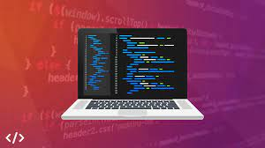
Out Line
Cloud to Edge Computing
Serverside computing
React
Next.js 13

Slide 3
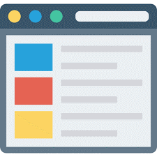

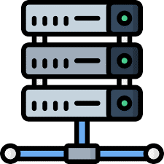
Introduction (General)
Web Page
Website
Server
A document which can be displayed in a web browser such as Firefox, Google Chrome, Opera, Microsoft Internet Explorer or Edge, or Apple's Safari. These are also often called just "pages."
A collection of web pages which are grouped together and usually connected together in various ways. Often called a "web site" or a "site."
A computer or device performs specific functions to manage, store, and process data. It is typically connected to a network and is Responsible for managing access to shared resources, such as websites, databases, and programs.

Slide 4
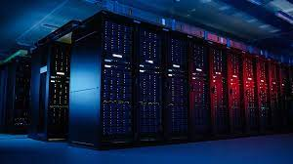
Introduction (Common Disadvantages of Servers)
Servers Common Risks are:
Infrastructure scalability issue
Expensive to maintain and upgrade
Minimal data backup and recovery
Single point of failure
Platform Dependency

Slide 5
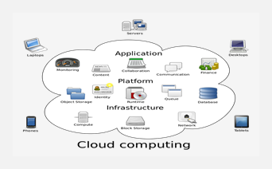
Introduction (Cloud)
Characteristics
On-demand Self-service
Broad Network Access
Resource Pooling
Rapid Elasticity
Measured Service
Benefits
Improved performance
Instant update & free software
Device independence & Mobility
Reduce capital expenditure
Fast Deployment & Continuous Service Delivery
Cloud computing is the delivery of computing services, such as servers, storage, and software, over the Internet. It allows individuals and organizations to access and use shared computing resources on demand, without maintaining their own physical infrastructure.

Slide 6
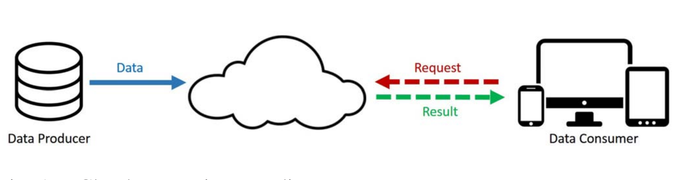
Introduction (Cloud Architecture)
Cloud

Slide 7
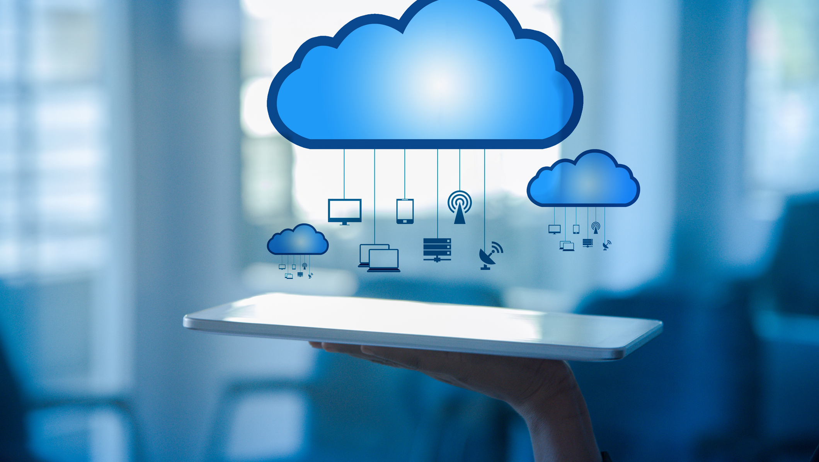
Introduction (Common Disadvantages of Cloud)
Common Risks of Clouds are:
Account or service hijacking
Denial of service attacks
Bandwidth consumption
Data latency rate is high
Centralized
Realtime interaction

Slide 8
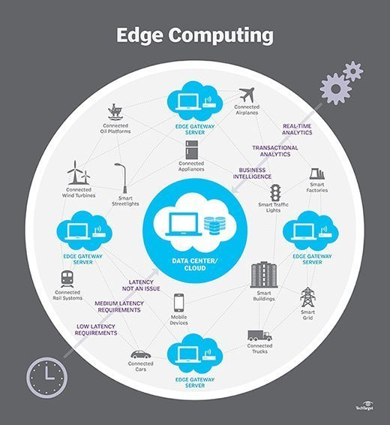
Introduction (Edge Computing)
Characteristics
Distributed data over different locations
Location awareness while accessing services
Low latency
Save Bandwidth
Reduce Congestion
Benefits
Performance is better
Privacy and security are better
Cost and time efficient
Reliability in terms of access
Edge computing is essentially bringing the computing resources closer to the devices needing it, such as Computer, mobile phones or vehicles.

Slide 9


Introduction (Edge Architecture)
Extracted Data
Raw Data
Result
Result
Edge Server
Cloud

Slide 10
React and Next.js 13
Server in Web Application Context
React
Next.js 13
Server refers to the computer in a data centre that stores your application code, receives requests from a client, does some computation, and sends back an appropriate response
Client refers to the browser on a user’s device that sends a request to a server for your application code
React is a JavaScript library for building interactive user interfaces
React provides helpful functions to build UI
Next.js is a React framework that gives you building blocks to create web applications
Framework, is how Next.js handles the tooling and configuration needed for React, and provides additional structure, features, and optimizations for your application

Slide 11
Magic Moment (The Concept)
Fetching code through optimization in Next.js 13 through :
Origin servers
Ordinary server is just a name of a server
origin server receives a request, it does some computation before sending a response. The result of this computation work can be moved to a CDN (Content Delivery Network)
Content Delivery Networks (CDNs)
CDNs store static content (such as HTML and image files) in multiple locations around the world
Placed between the client and the origin server
When a new request comes in, the closest CDN location to the user can respond with the cached result
Edge
Edge is a generalized concept for the fringe (or edge) of the network, closest to the user
CDNs could be considered part of "the Edge"
Unlike CDNs, which store static content, some Edge servers can run small snippets of code

Slide 12
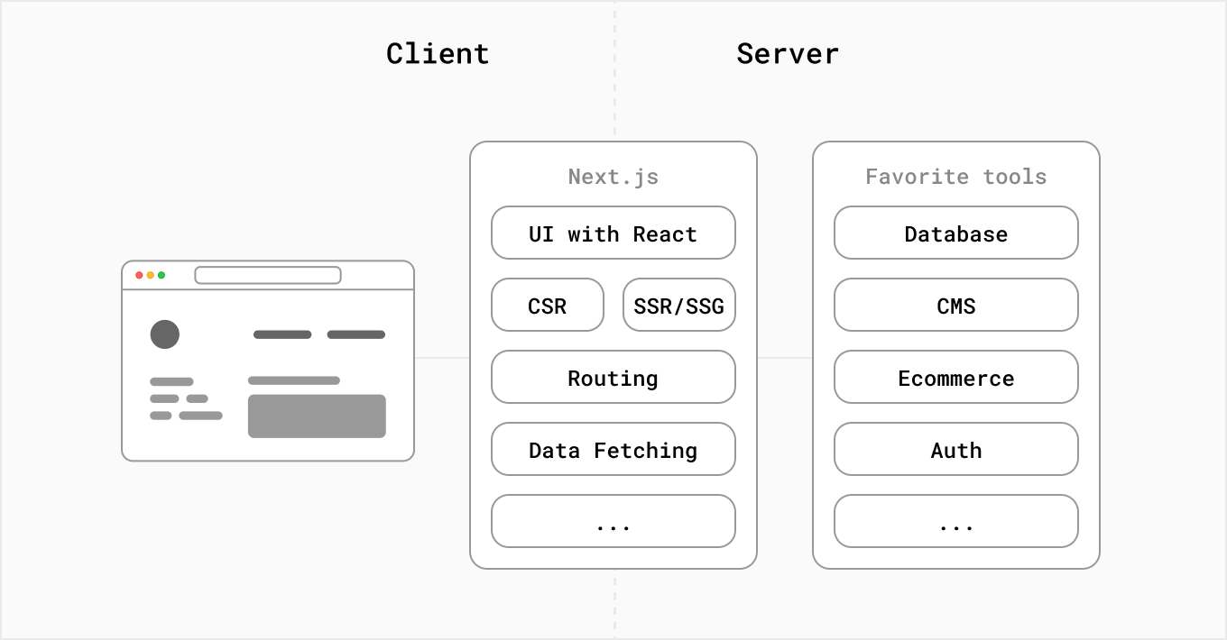
Magic Moment (Architecture)

Slide 13
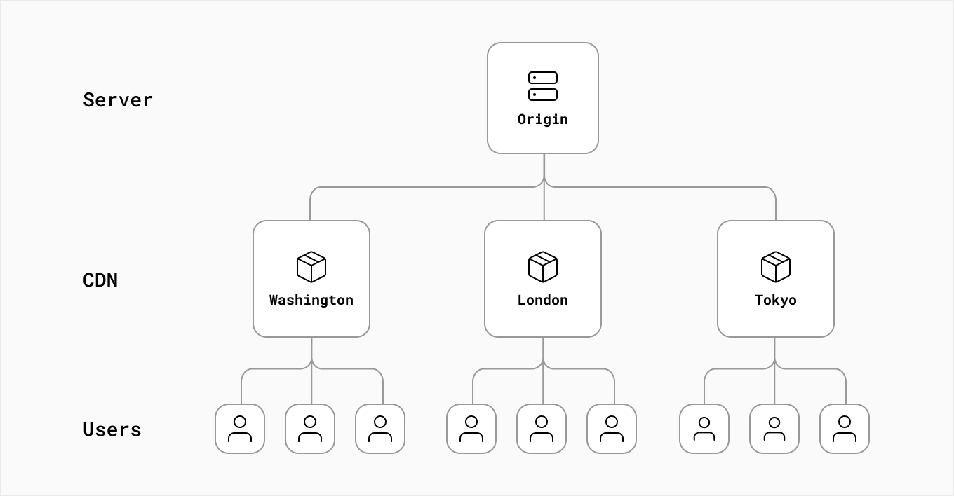
Magic Moment (Conceptual Flow)

Slide 14
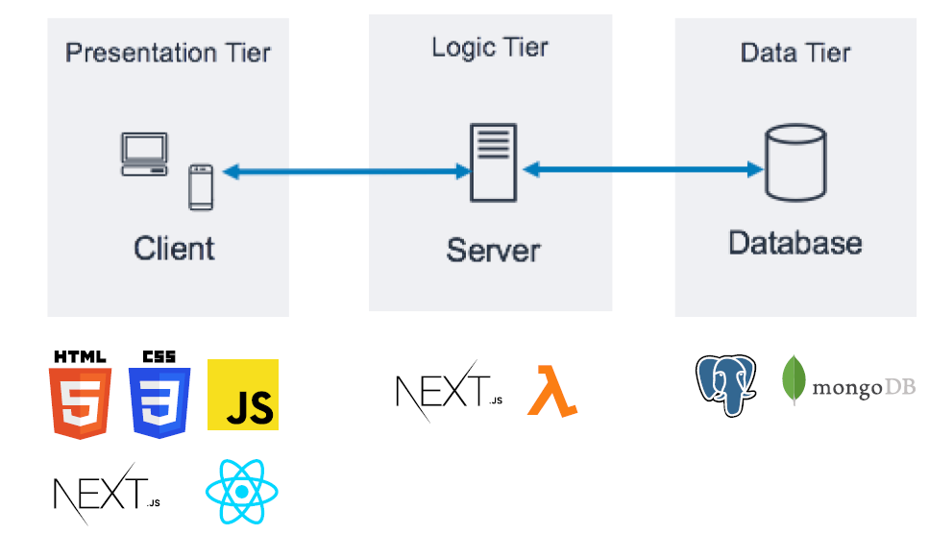
Magic Moment (Request Flow)

Slide 15
Advantages
Business Owners
Markets
Developers
Unique user experience
Adaptability and responsiveness
Data security
Faster time to market
Fully omnichannel
Short page load time
Support on demand
Higher sales numbers
Increased conversion rate
Organic traffic growth
SEO efficiency
Unique user experience
Reusable components
CSS parser
Built-in Image Component and Automatic Image Optimization
Community support
Fast Refresh
Incremental Static Regeneration
Data fetching
API routes
Code splitting

Slide 16


